Slide 1

Project White Spectra
By Nikodem Drabik

Slide 2
Project
Vision
Notes:
Create a single page application that with navigation for those who struggle to understand the internet and how to navigate it safely.
Reasons for choosing people who struggle:
No current substitutes on the market. No company created such webpage
Mass amount of vulnerable people taken advantage of on the internet
This creates an almost 100% secure environment if the users end up using this webpage
The following points will be expaned on in the next sliedes

Slide 3
Project Vision
Project Idea:
Create a Single Page Application that assists in the use of the internet
This Project Will:
Be Designed for people who struggle with the internet/are vulnerable
Allow user to navigate the internet with ease and better security.
Have a Secure password creator.
Section dedicated to E-Safety
This Project Likely:
Have a built-in password Manager with secure encryption of data
This Project May:
Have Google’s search engine API
Notes:
Create a single page application that with navigation for those who struggle to understand the internet and how to navigate it safely.
Reasons for choosing people who struggle:
No current substitutes on the market. No company created such webpage
Mass amount of vulnerable people taken advantage of on the internet
This creates an almost 100% secure environment if the users end up using this webpage
The following points will be expaned on in the next sliedes

Slide 4
Project Background
User Ability
Web Interface
Ease of use
Skill
Cyber Criminals:
Exploitation
Scams
Poor Password
Notes:
Project Background
There are two main reasons for my project these area Cyber & user
User Ability
Intended users often struggles to navigate the web as such I have decided to create a very easy to use web interface. A factor that caused me to do this project was based on personal reasons.
Many functions I do and do not think twice when doing it others struggle with. For example, my grandmother no matter how many times I show her how to use the internet she does not understand it which led to me putting links on her homepage.
This gave me an idea to make a universal type of web page that does that functions is organized and widely adapted for anybody to use.
This will hopefully allow this to be sorted.
Cyber Criminals
Secondly reasons for deciding on this project idea is that there is a large number of Cyber Criminals exploiting people such as the elderly and children via scams and phishing attacks.
Watching many documentaries and videos on how such operations are conducted and how to safely use the internet I thought about how to pass this knowledge on and how to also possibly help them to not be affected.
My aim is to minimize these threats.
This led to me deciding on creating a safe hub where all the websites connect are safe and will lead to the correct source the user wants.
Secondly poor password creation leads to vulnerability of passwords being easily brute forced.
All these issues lead to me creating my project vision and plan as I could not find any current programs or webpages that do this type of assistance to the elderly .

Slide 5
Sprint 1

Slide 6
Aims:
Research possible solutions for the project
Research how to design websites
Begin Visualising a Solution
Notes:
Research possible solutions to implement them in my project.
How to design the websites so that they are visually appealing and somewhat presentable
Begin design a solution to then be prototyped.

Slide 7



Website hub
Features:
Icons that Connect to websites such as:
Facebook
Emails
Bank – Quite important
Shopping
E-Safety Section:
Useful Recourses
Cyber Security Websites
Website featuring everyday tools.
Design Influence:
Users – Elderly
Children
Tech inept
Neurodivergent
Readability – Eyesight
Ease of Use
Eye appealing design
Versatility
Notes:
Design Influence
Readability - Old people struggle to sea
The design needs to be straight forward no over the top complicated inputs.
Eye appealing design as if the design is not well composed the users will not enjoy using it for example old iPhone Operating System compared to new IOS
Due to my intended use I want it to be able to be used by the different skill and age level of possible users this means-
May add ability to change websites – increase decrease amount displayed
Mobile Compatible
Low Processing Power- users may be using outdated devices

Slide 8
Google Search API
Language: JSON
Uses:
Allows User to search in the SPA
Cost:
Free 100 searches per day.
Future application requirements:
Costs $5 per 1000
Ads to cover this
Notes:
Allows user to use google search engine from my website sending them to the destination they searched for.
This will be located near the top as it is in fact a search bar.
Works- Like most search bars.
Takes you to the google screen with info about what you searched.
Uses- Allows for user to directly search on my site without the need for going to an external site
Costs- Currently it is free for up to 100 searches per day after that it will no longer work.
Futureproofing:
It costs $5 per 100 searches if I want to go over the 100 free searches
To mitigate this cost I thought about putting ads to cover the costs-
However Adds that will be located on my site may end up being predatory on my users as they are likely to by gullible
This leaves the issue of how to monetize my site to cover costs.
API

Slide 9
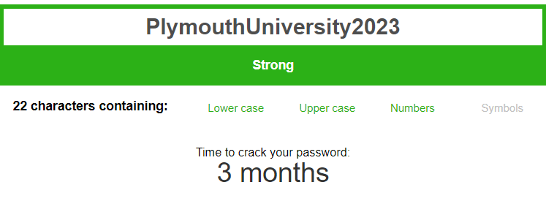
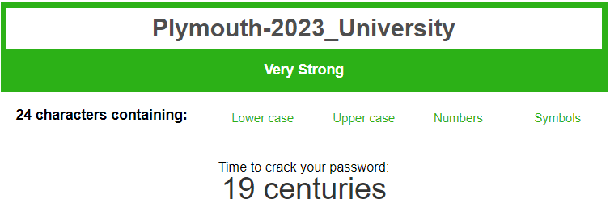
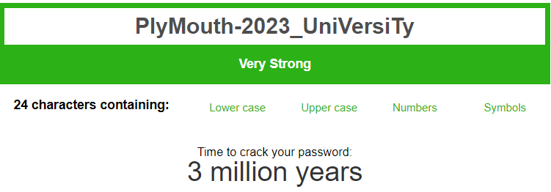
Password Creator 1
Encryption
Foreseen Problems:
English Language – Syllable Separation
User logic
Security – Brute Force
Data inputted -> Plymouth University 2023 No Special Encryption
Basic Generated Password -> Plymouth-2023_University First letter of each word
Strongest Generated Password -> PlyMouth-2023_UniVersiTy
Syllable Separation
Notes:
Idea:
Section of SPA
To have the user input the 2-3 words and 1 string of didits that have some kind of meaning to them to make it easier to remember;
That data will be scrambled hopefully by –
Hopefully, Syllables = Capitalised
Special Characters - _ @
Numbers integrated
Show better than basic input- future more computer power -> faster brute force -> long-term password == better
Issues:
User lack of skill - May lead to weak passwords
Syllables- Difficult to imitate the English language in code -> possibly impossible on such a small scale
Brute Force == Long Time / With my password generating logic -> weak
Password Management:
Storage -> Currently uses notepad stored in a cupboard can be bad or good regarding security
User Preference -> User prefers to store it physically. Have it in hand .

Slide 10
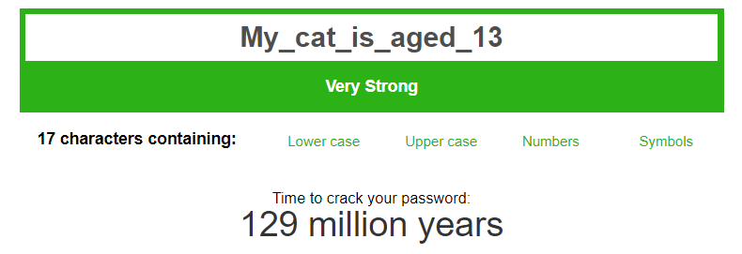
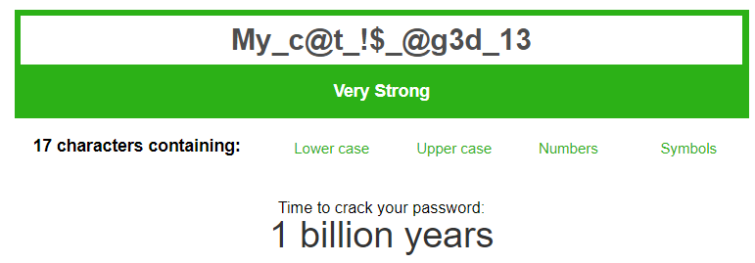
Idea 2:
By telling a story.
Password Creator 2
2 Ways both secure:
1.Basic
2.Secure
Example:
My cat is aged 13
After Algorithm 1:
My_cat_is_aged_13
After Algorithm 2:
My_c@t_!$_@g3d_13
Pros-
Both Secure
Easily memorable story
Cons-
Possibly hard to memorise encryption rules
a=@
i=!
S=$
e=3
O=0
Hashing:
Notes:
During the second sprint I saw a clip from a podcast regarding Cyber Security it was too go0d of advice to be not included in the project.
The cyber security analyst recommended this type of password encryption for children to keep safe online. In my opinion this is a very smart way creating passwords.
This can apply to my project also includes children
Password 1
The password would be done by a very basic type of algorithm applied to change spaces to _
Password 2
The password will have letters changed to symbols or numbers such as (read)
Reasons for this style then other
This greatly increases the security as the password can be longer yet easily memorable. It does not need to stop here it can be even longer like “The cat and the dog both like to have tea at 3”

Slide 11
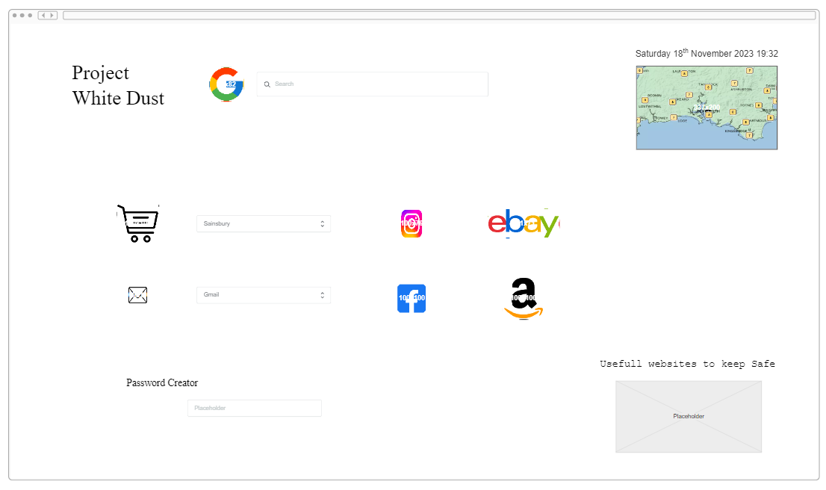
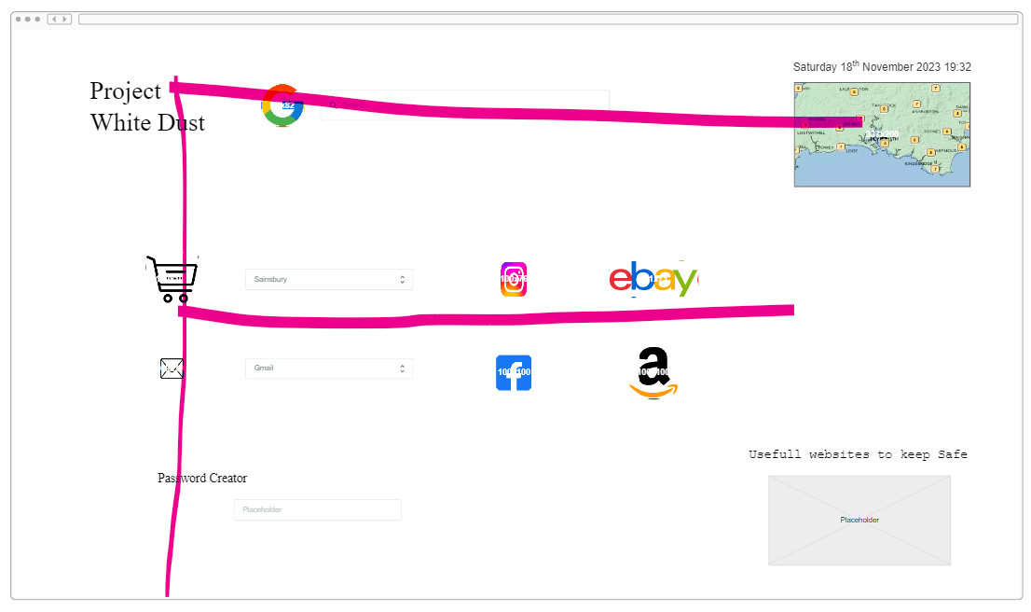

Project Visualisation 1
Breaking Down Idea and Creating first prototype
- Prototype 1
Improvements Requited:
Layout
Low information
Drop down- complicated
Design style in correlation with Human eye Tracking
Notes:
Sprint 1:
Non functioning web page.
Used program that allows to style web pages.
Used to create Ideas and to create an initial prototype-
work out Good and bad ideas
Different skills
What works -> apply in the next prototype
Everything else re-design
Researched web page layouts:
The F scan-
Humans look at web pages in an f pattern
Put information where people look.
Improvements from 1st attempt:
Layout is very bland and the whole design does not look eye appealing in my opinion.
The amount of information displayed is not enough and the way it is located seems just unorganised and cluttered
Drop down seems to not be as useful as I thought it would be as it is slightly complicated.
Before sprint 2- looked at other peoples HTML basic webpages and influenced by it.

Slide 12
Sprint 2

Slide 13
Aims:
Create Website
Create User Interface
Create a basic Input to JavaScript on the website

Slide 14
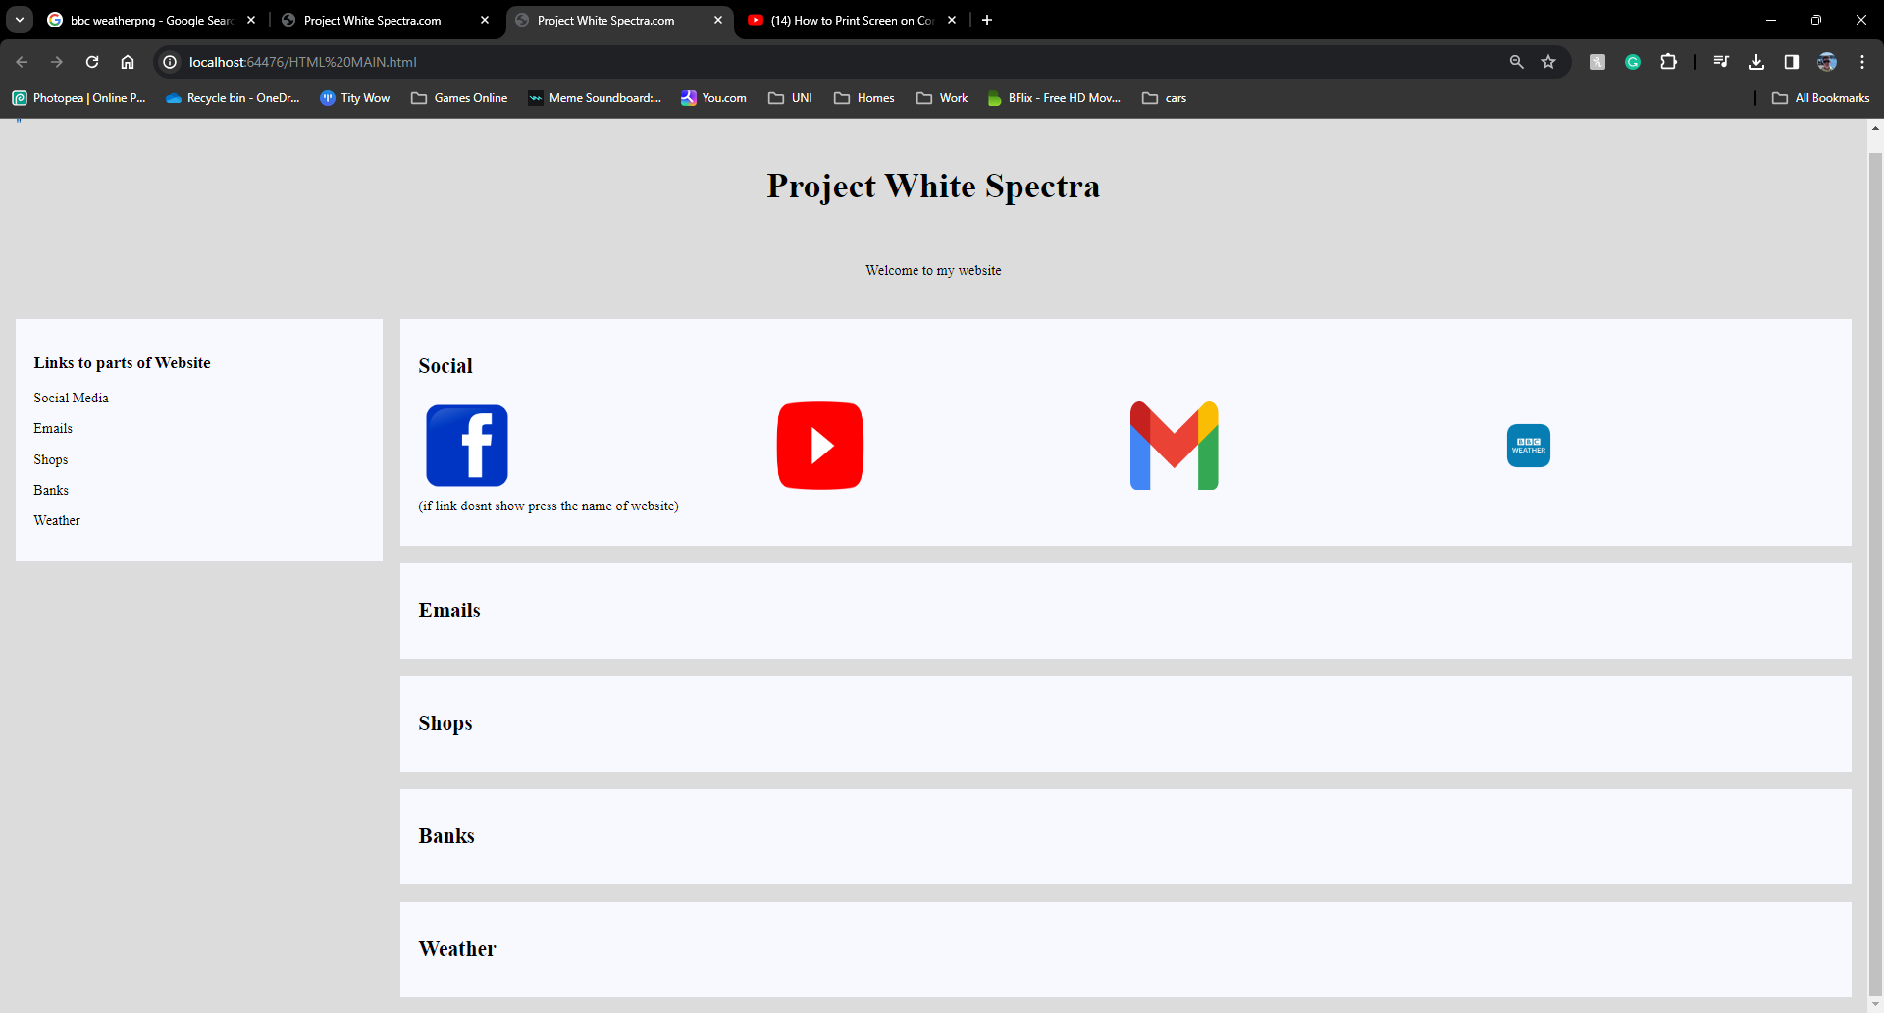
Prototype 1
Written using HTML, CSS and JS
Main Body –
Basic Interface
Separate Areas
Image = Links
Easy to Navigate
No drop downs
Side Bar (non-functional)–
Moves screen to designated area
Shows all Areas
Easier Navigation
Notes:
Hypertext Markup Language
Cascading Style Sheets
Java Script
Main Body –
Basic Interface creates makes it much easier to use the website it is less cluttered
Separate areas allow for the webpage to be organised in a very intuitive way
Decided to use Images as Links -> much easier to understand and intuitive like a Icon on a phone screen or on the computers ___
These to things make it much easier to navigate the webpage compared to my first prototype
Removed drop downs as this was one of the thing I found to be complicated and cluttered
Side Bar-
Current state == Non functioning - > finish designing main body
Current function-> changes colour when hovering over to indicate it can be pressed. ->ease of use
Intended uses-
Moves with Webpage as user scrolls
Shows all features of the webpage when clicked moves to that area of screen with that data.
Overall, this will make it easier to navigate the webpage.
Future Issue-
Mobile Users in portrait Mode
Where does it go
How will it function

Slide 15
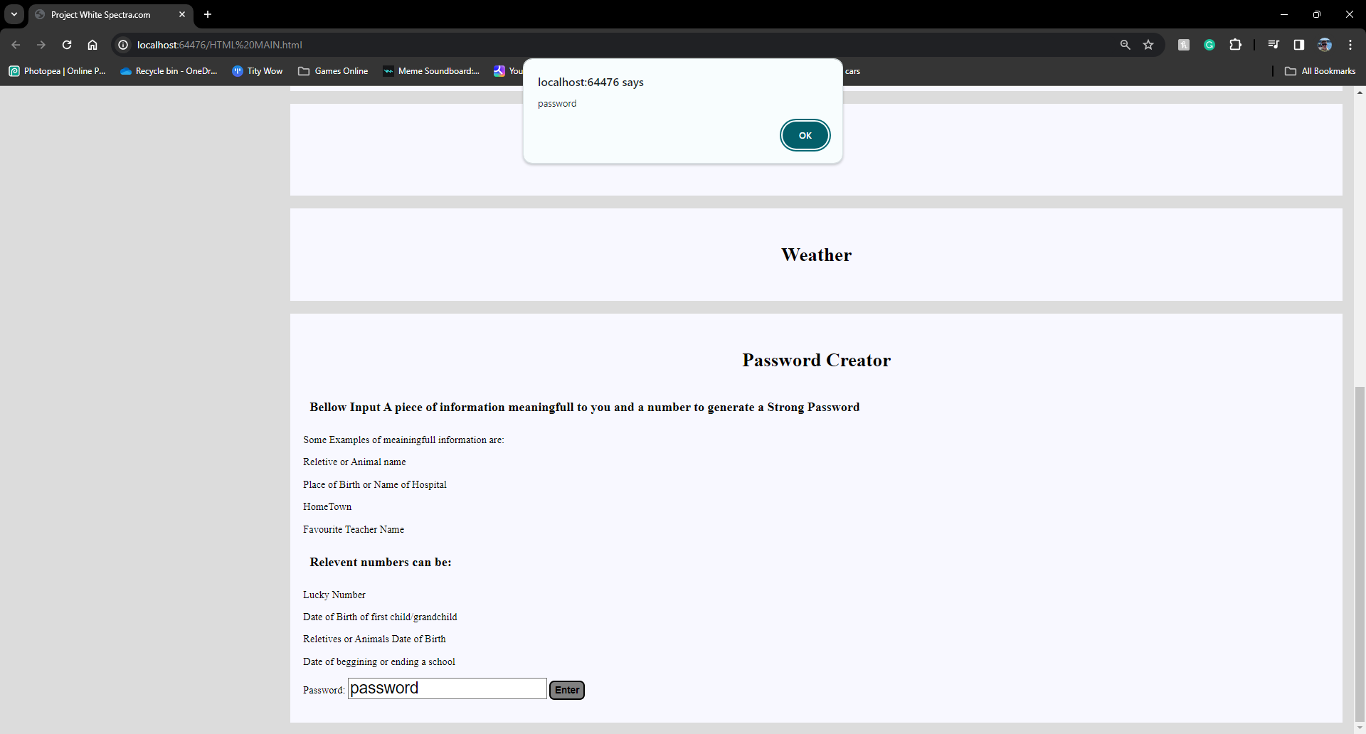
List of Hints-
Secure password
Lowers User Related issues
First Time Making Password
Straight forward process
Password UI-
Logical Location (After Hints)
Enter Button Changes colour when hovered over
Uses-
Data read by JavaScript File
Allows to do encryption Algorithm
Returns the Data to user
(Currently Only Receives data and confirms it via an Alert)
Password Creator 1 -Protype
Notes:
This is the prototype for the first idea for the password
List of hints reason for existence-
Target users will struggle to create a strong password.
Hints should provide some idea of data to input
The password should also be tailor to the user and who knows the most what is relevant to a user then the user
Should make the password making process much easier
UI-
Location at the bottom of all hints -> user should read the hints before attempting to input data.
Enter Button changes colour to show it is active.
The input Location is ladled Aswell “Type Data Here” however it is not showed in the screen shot to show that the data input works
Uses-
The main function of this is to get the data and to then manipulate it and then after that return it to the user.
The manipulation will be the technique I explained on the previous slide
Currently all the functionality it has it takes data in and then returns the exact same data to the user.

Slide 16
End of Sprints

Slide 17
Create a password management
Stored Locally not in the cloud
Encrypted (Cipher)
Navigation Bar
Move screen
Google API integration
User can search using the API
Usable by different devices
Aspect ratios
Mobile vs Computer
Customization
Different Links displayed.
Preference is saved
Colours
Future Sprint Ideas

Slide 18
UML Diagram
HTML
HTML
Java Script
“website” icon
Password Button
Language: HTML
Href-”Website URL”
Purpose: “Link to websites”
Language: HTML
Id-Button1
Onclick-Password_Button()
Purpose: “button”
Password_Button()
Website Link
Language: Java Script
Const- User_Input
Var – User_Pass
Future: encode algoritm
Purpose: “encrypt data”
Password Creator
Return data
Input Password text box
Language: HTML
Type-Text
Id-User_Input
Purpose: “Input box”
Get element by id
Notes:
Href-Hyperlink Refrence

Slide 19

User Stories
User Interface
Program
User wants to access “website”
“Website” Icon
HTML executed
Redirect to “website”
Press
User loads Website
Current
User wants to create password
Password inputted into box
Algorithm executed
Returned to user
Input password
JS file reads it
User wants to use search engine
Data transferred
Google API searches and redirects user
Input data
Text Box
Future
User wants to navigate website
Moves screen to section
Affect user Interface
Press
Name of section
HTML executed

